Slide 1
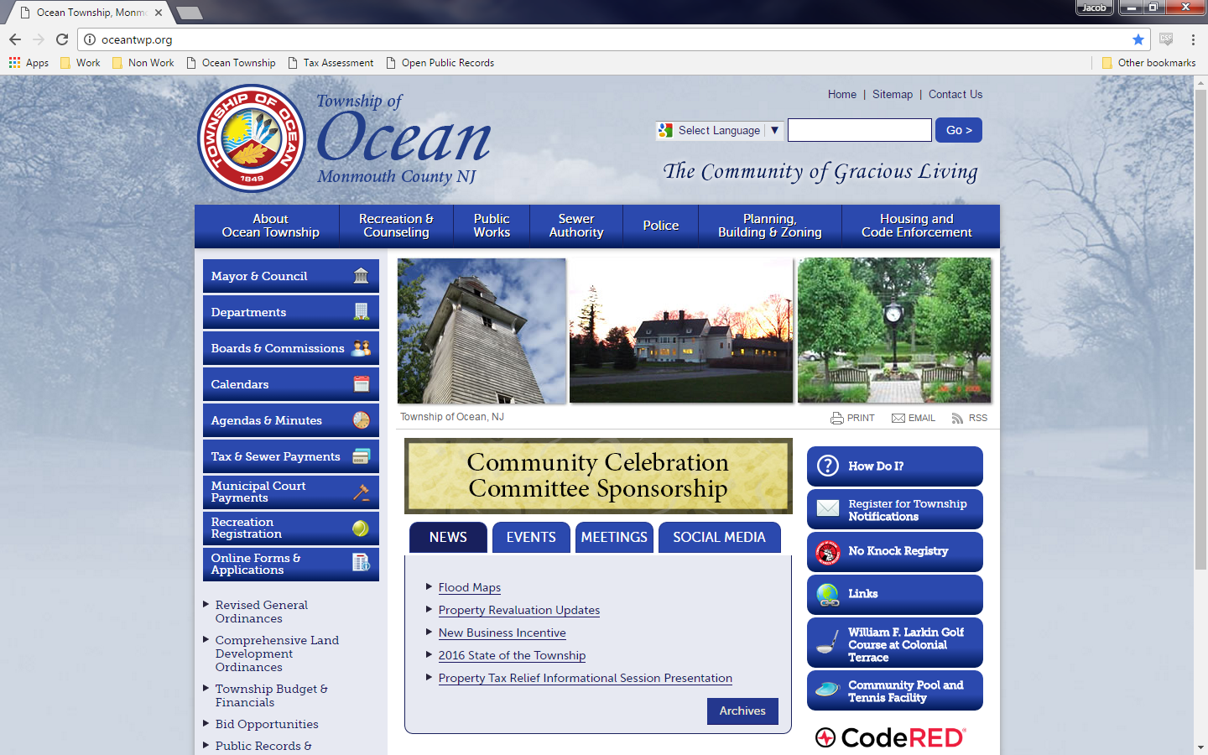
To Access the Assessor’s Resources select departments below

Slide 2
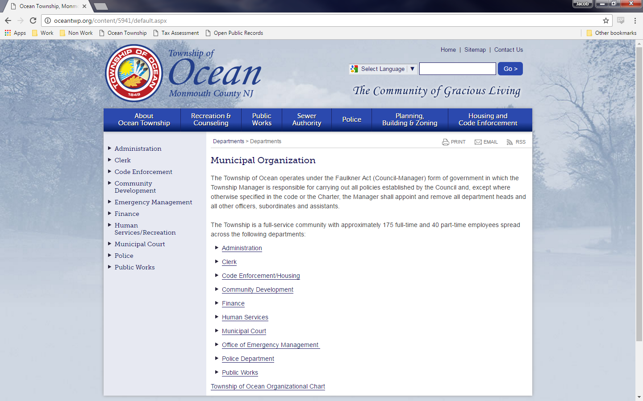
Choose Finance

Slide 3
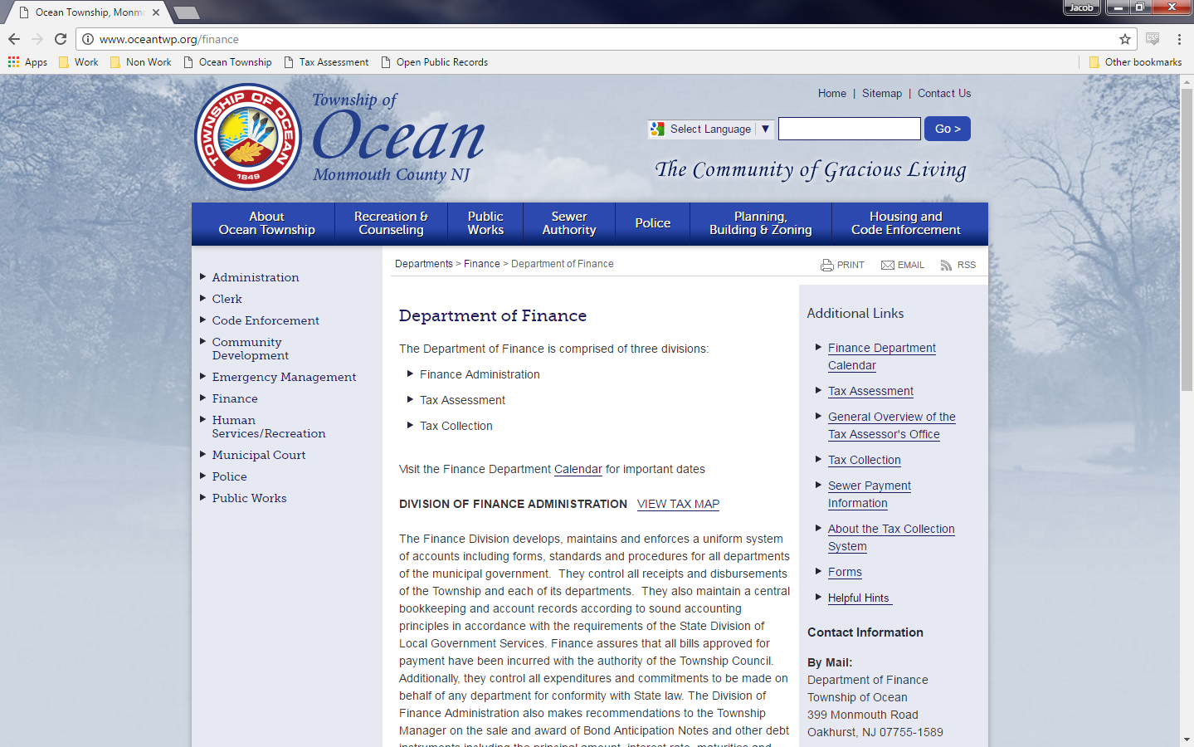
Select Tax Assessment

Slide 4
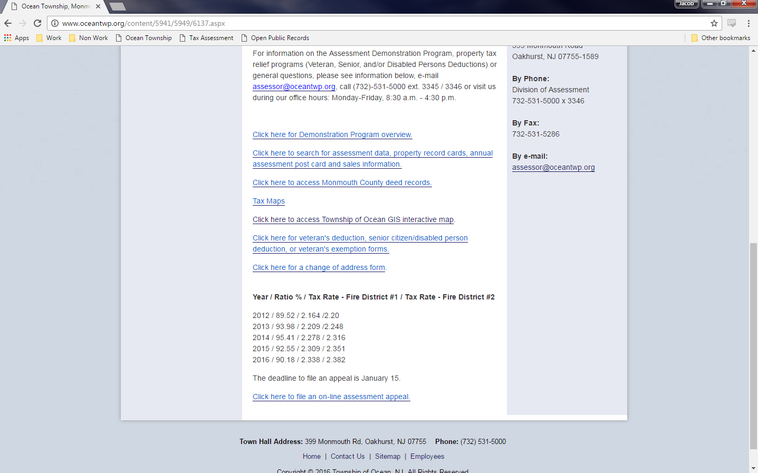
For Property information, Sales Data, and Assessor Records (post cards and Property Cards choose here

Slide 5
Appeals can be filed via this link.

Slide 6
Address Change Forms are found here

Slide 7
Deed records are also available going back until 1976.

